Slide 1

About me
AMNA WALI KHAN
ERP 24664

Slide 2
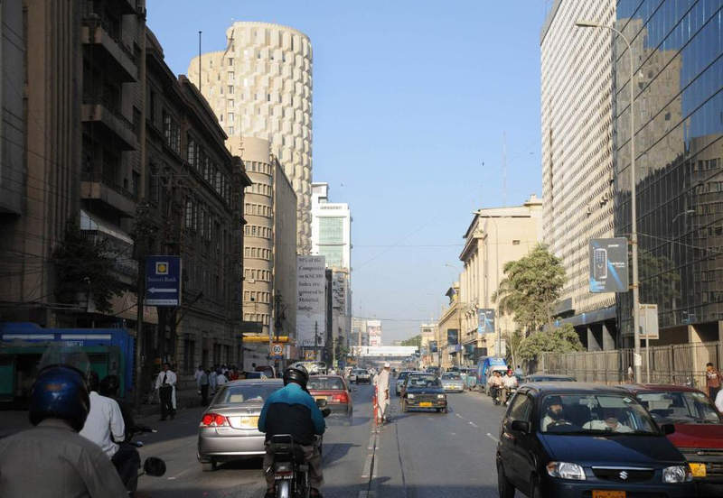
Born on June 25th 2001 , Karachi Pakistan

Slide 3
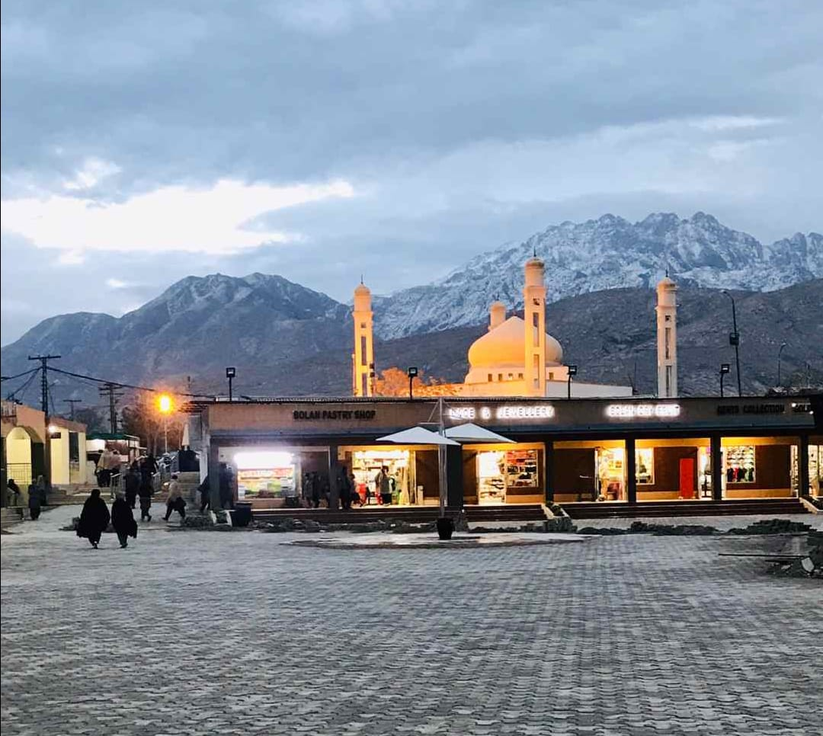
Spent the first 7 years of my life in my hometown Quetta

Slide 4
Then my parents decided to move to Karachi

Slide 5

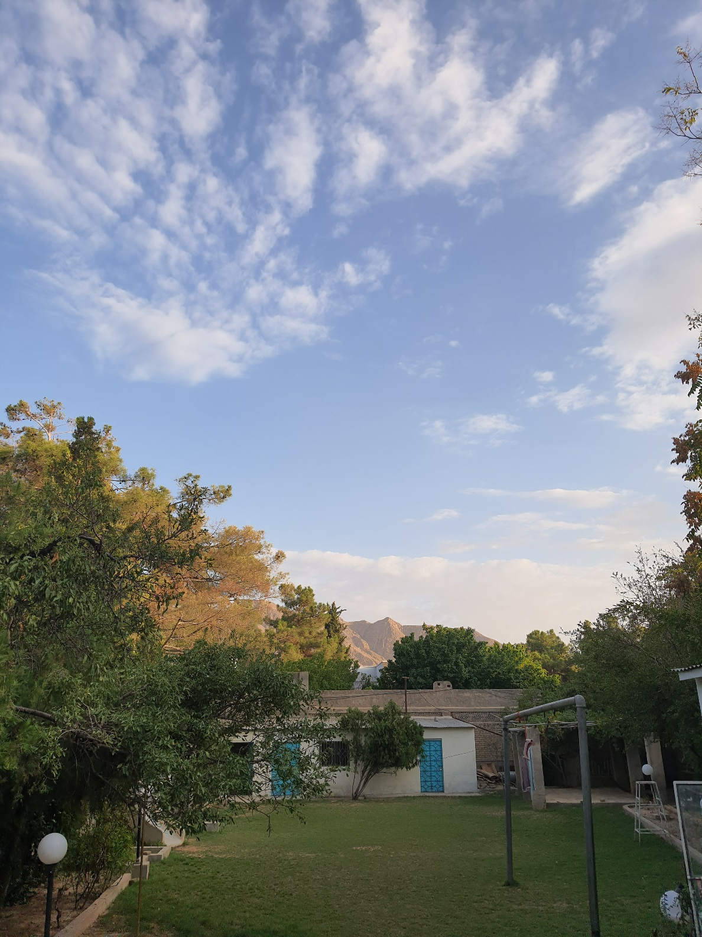
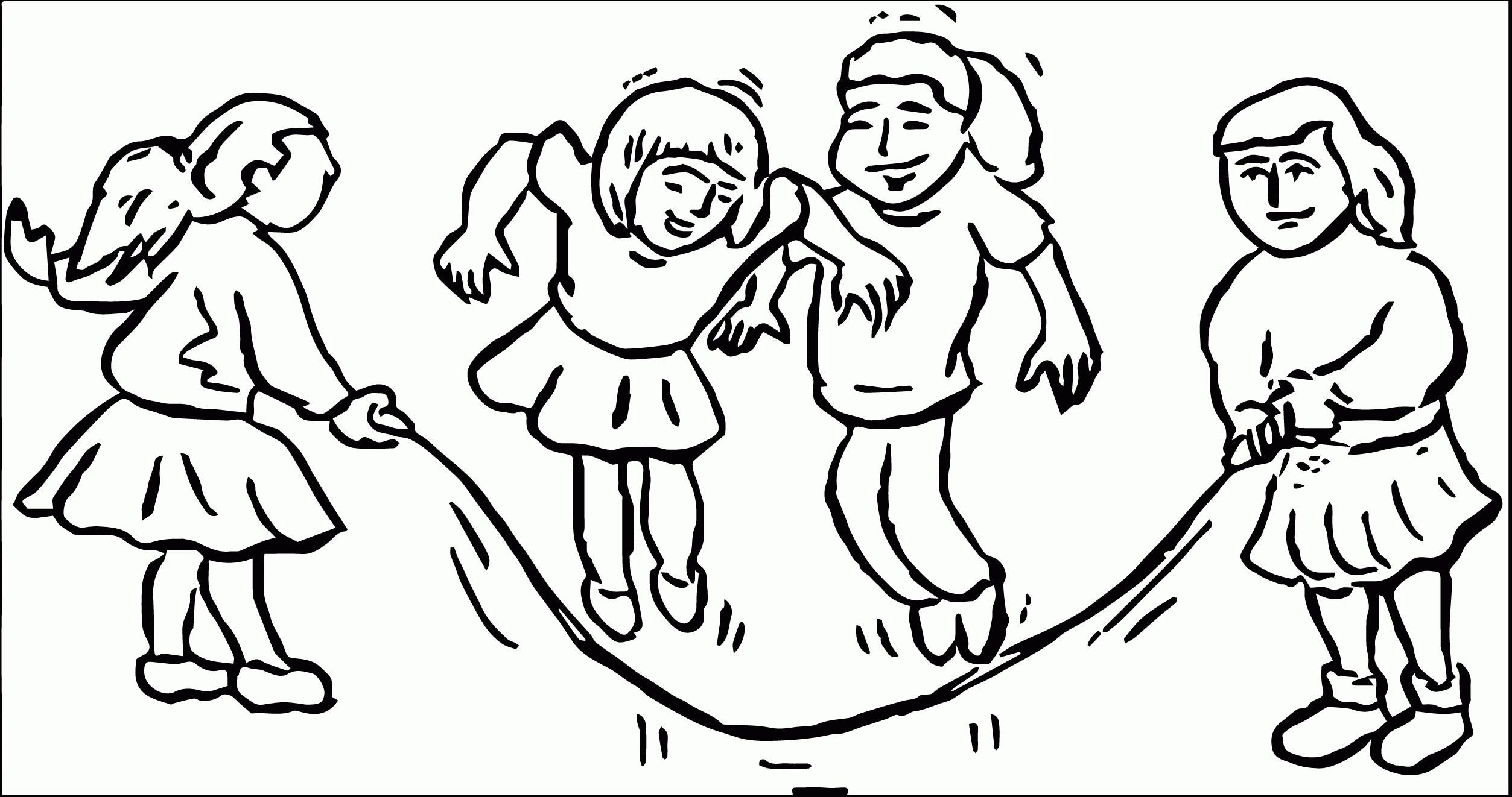
Which is why my siblings and I weren’t so happy
Which meant leaving our home..
… and the friends and family we had always known.

Slide 6
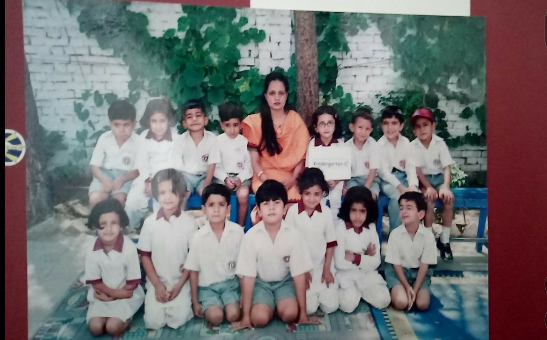
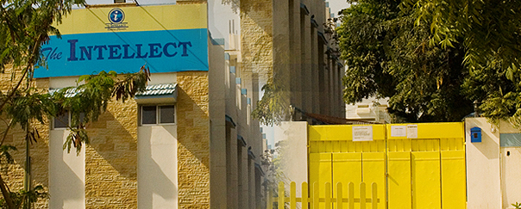

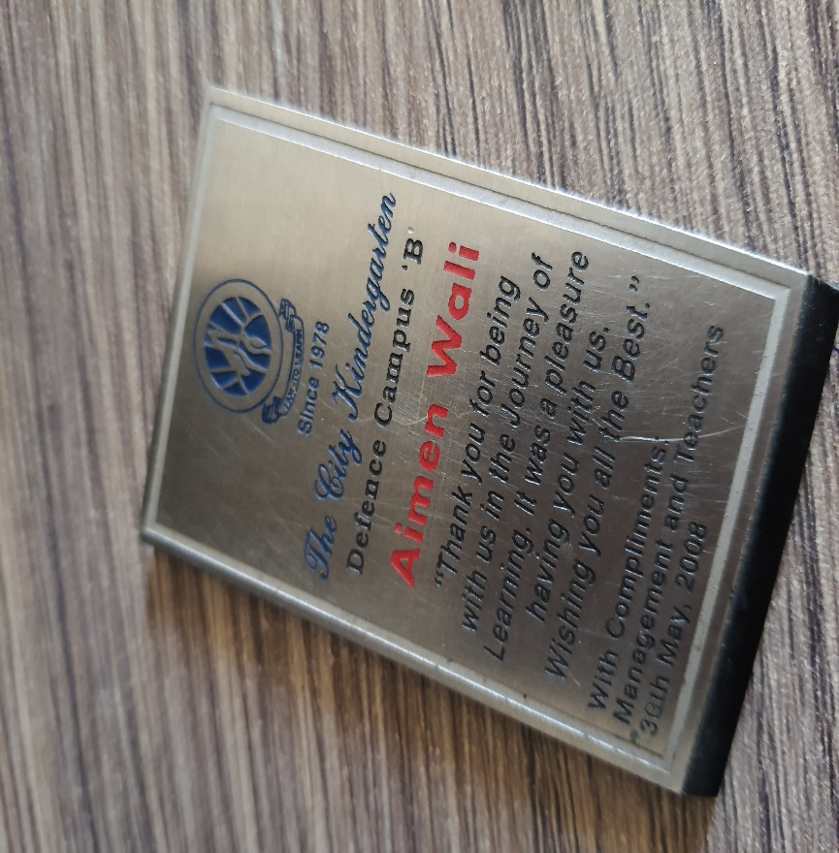
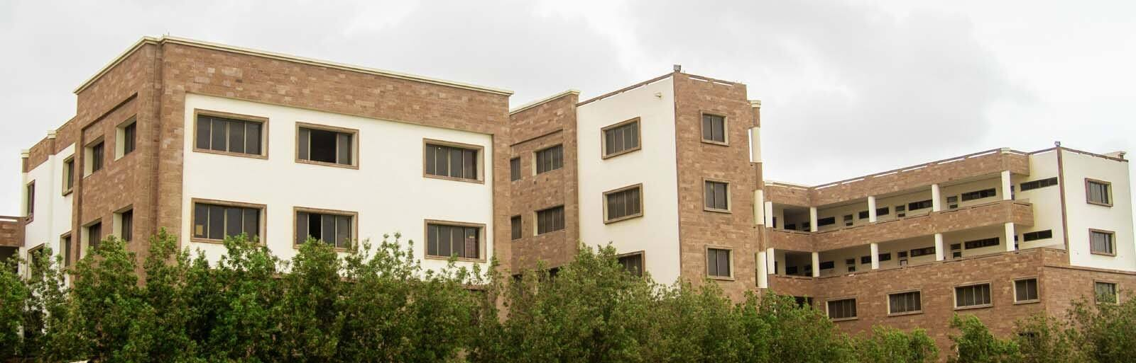
My parents decided to change my school after I completed 2nd grade.
This is when they changed my name from Aimen to Amna
That’s me

Slide 7




I was never the best when it came to academics
But luckily I discovered my talent for singing and debating, the 2 things I always excelled at in school.

Slide 8


After I graduated from Olevels, I decided to do my Alevels as a private student
During this time, I discovered my love for fitness.
I also started to excel academically

Slide 9
After completing my secondary education, I had no idea what I wanted to choose for my career

Slide 10
So I decided to take a gap year and did this 1 year course that I had wanted to do

Slide 11

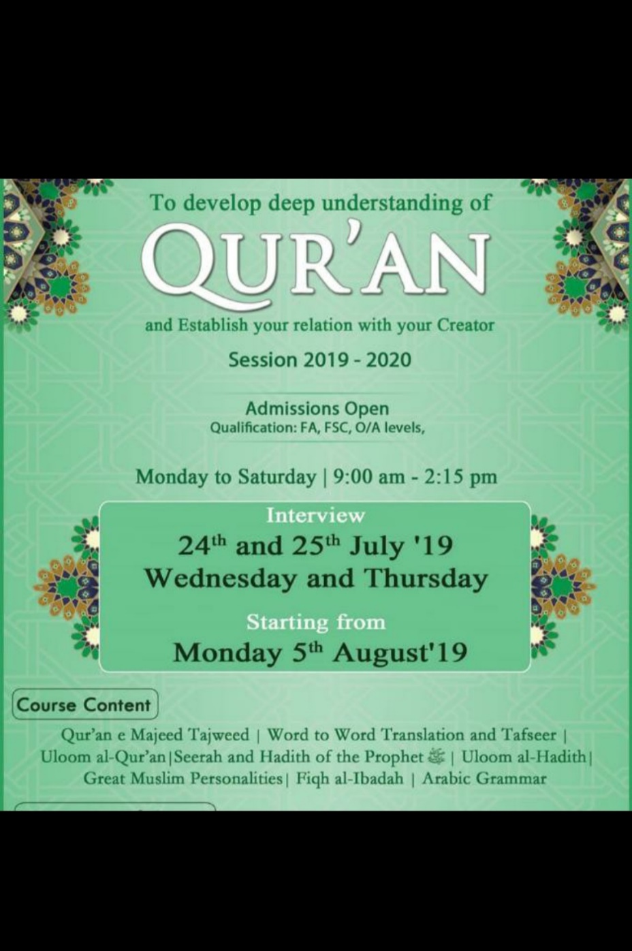
In this course I learnt about:
I grew a lot as a person and met the
most amazing people through
this course
Buddhism
Sikhism
Judaism
Christianity
Hinduism
Detailed Explanation Of The Quran
Translation Of The Quran
Arabic Grammar
Islamic History
And Other Aspects Of Islam

Slide 12

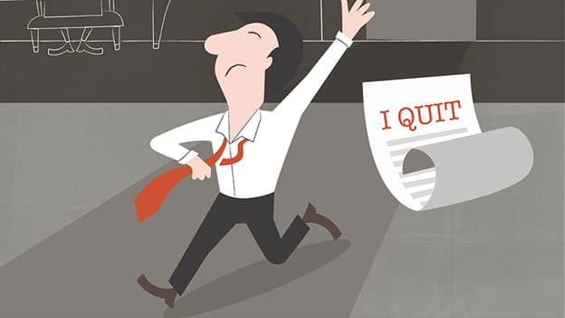
Once the year finished, I had decided to try for engineering University although I still wasn’t sure what I wanted to do
I applied to NED and got accepted. Chose Chemical Engineering.
But sadly, things did not work out the way I thought they would.
After 7 months of contemplating, I decided it wasn’t a good place for me

Slide 13


The only problem now was…
I still had no idea what I wanted to do!

Slide 14


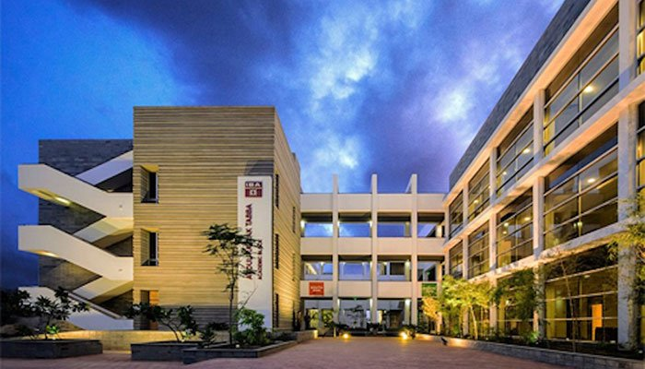
After a lot of thought, I decided to apply for a business major
I got accepted at both and chose IBA

Slide 15
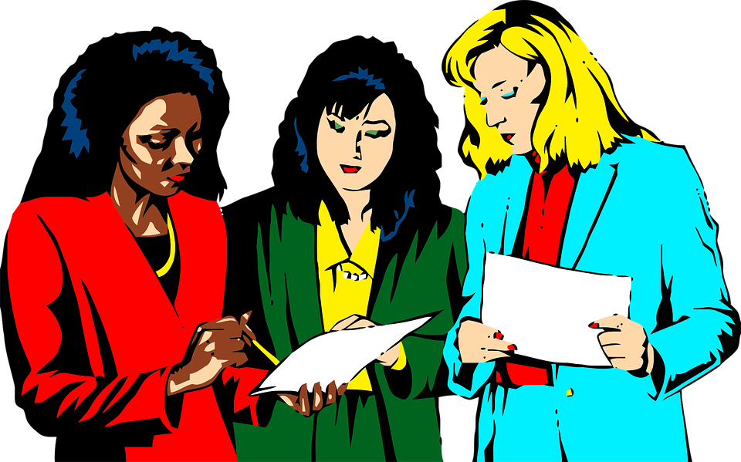
I hope to become a successful innovator and entrepreneur and entrepreneur

Slide 16

To conclude exactly who I am,
To the world, I am Amna Wali Khan,
To my family I am Aimen,
But to myself, I am a flawed human being aspiring to be the best version of myself.

Slide 17

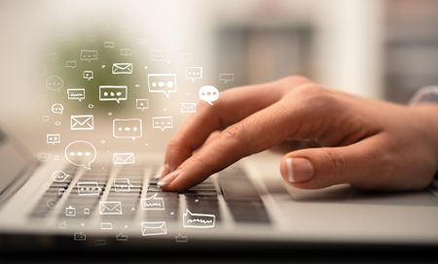
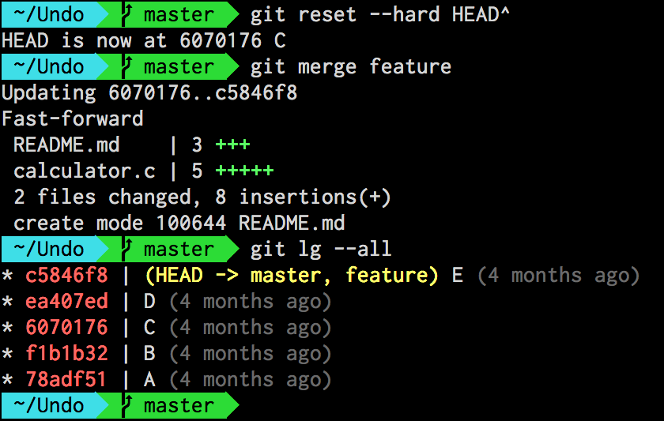
Overall, I think it is safe to say that I have upgraded a lot when it comes to my understanding of computer applications
to learning how to effectively use MS Excel and MS Word
From improving my typing speed
Also explored new computer functions like Git
And I am extremely grateful for all of it

Slide 18
(I tried to add an audio but there was a problem in my laptop)

